Slide 1




2012 Summer Student Research Training (2):
Statistical Techniques in Clinical Studies
Ching-yi Shieh, Ph.D.
National Institutes of Health
Mark O. Hatfield Clinical Research Center
Rehabilitation Medicine Department
July 5, 2012

Slide 2
Last week:
What is quantitative research;
Data management;
Basics of quantitative research;
Population vs. Sample; Parameter vs. Statistics; Sampling distribution
Hypothesis
Type 1 and Type 2 error
Variables and levels of measurement
Research design

Slide 3
Today:
Our goal: Gain a general understanding on how to apply statistical methods to your research projects.
To be covered in this session:
Central tendency and dispersion.
Normal curve, Z-score, and hypothesis testing.
Parametric vs. Nonparametric statistics.
Frequently used statistical techniques in clinical study.
Questions?

Slide 4
Central Tendency and Dispersion

Slide 5
Central tendency
The most common value (for nominal measures) or the value around which other cases tend to cluster (for numerical measures).
Measures of central tendency are usually reported with a summary measure of variability or the distributions themselves to preserve aspects of the shape of the distribution.

Slide 6
Central tendency (Cont.)
Mode: A measure of central tendency by finding the score in a sample that has the highest frequency of occurrence.
For example, in a set of score [64, 64, 64, 71, 73, 74, 75, 75, 82], “64” is the mode. It is possible to have multiple modes.
Median: A measure of central tendency by ranking the scores in a sample from lowest to highest and identifying the score that has 50% of the scores below it, and 50% of the scores above it.
With odd number of cases [64, 69, 70, 71, 73, 74, 75, 80, 82], “73” is the median.
With even number of cases [64, 69, 70, 71, 73, 79, 81, 80, 82, 90], the median is the averaged score of the two middle cases, so (73+79)÷2=76.
Mean: The arithmetic average. Add up the value from each individual and then divided by total number of observations.

Slide 7
Measures of dispersion
The extent to which cases are spread out through the distribution.
Often used measures of dispersion:
Range (Maximum-Minimum).
Variance.
Standard deviation.

Slide 8
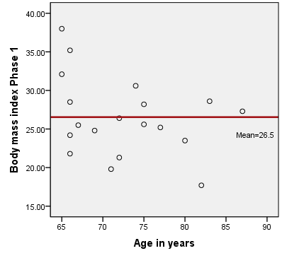
Measures of dispersion (Cont.)
Variance: Summary information about the distance of individual X scores from the mean of the sample.
Standard deviation: The square root of the variance.
Where: M = mean;
N = number of cases (N-1 to adjust for
the sample estimate);
∑ = sum over all cases;
= value of case i on variable X;

Slide 9

Example of central tendency and dispersion
The variable is “Patient’s Age”. How do you interpret the results?
Central Tendency
Range
=(Max-Min)
Dispersion
Std. Deviation
= Square root of the Variance
Notes:
https://www.khanacademy.org/math/statistics-probability/summarizing-quantitative-data

Slide 10
Normal Curve, Z-Score, and Hypothesis Testing

Slide 11
Normal curve and Z-score
Important concepts in statistics.
A normal distribution is shaped like a bell, is symmetric, and is centered on the mean.
Converting data into Z-score: (standardized score)
In a normal distribution, 68% of cases fall within plus or minus one standard deviation from the mean, and 95% fall within two standard deviations.
Where s= Standard deviation

Slide 12
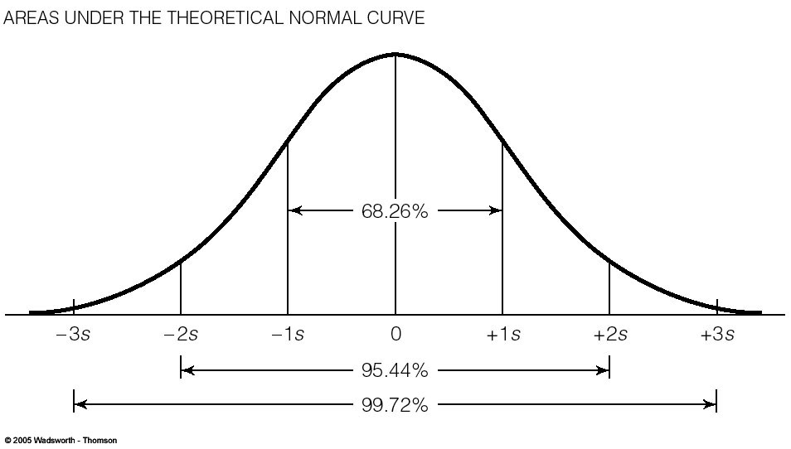

Slide 13
Confidence interval, critical region, and Alpha
Confidence interval: Is a range of values above and below a sample statistics that is used as an interval estimate of a corresponding population parameter.
Critical (rejecting) region: The end of the distribution curves. Areas with unlikely sample outcomes.
Alpha level (also called as “significant level” or “p-value”) is the probability that null hypothesis (H0) will be rejected when it is correct.
In the statistical analysis, researchers usually use 3 alpha levels:
Alpha (p-value) | Confidence Interval | Risk of Error
P< .001 | 99.9% | 0.1%
P< .01 | 99 % | 1 %
p< .05 | 95 % | 5 %

Slide 14
Alpha and estimation errors
When we perform a hypothesis testing, if the p-value generated by the statistics falls inside the defined critical region, we reject the null hypothesis.
Adjusting the Alpha will change the confidence interval and the critical region. Researchers should know how their analytical decisions affect the Type I and Type II errors.
Although some hypotheses do not reach p<.05 significance, researchers may still want to discuss whether the examined relationships demonstrate “clinical significance”.
Notes:
https://www.khanacademy.org/math/statistics-probability/modeling-distributions-of-data

Slide 15
One-tailed and two-tailed test
In a one-tailed test:
If the H1 is hypothesized as having a greater value than in the H0, we place the entire critical region in the upper tail.
If the H1 is hypothesized as having a smaller value than in the H0, we place the entire critical region in the lower tail.
In a two-tailed test:
we split the critical region equally into the upper and lower tails of the sampling distribution.
Z (critical) for one-tailed tests are always closer to the mean of the sampling distribution. Therefore, a one-tailed test is more likely to reject the null hypothesis for a given alpha level.
Notes:
https://www.khanacademy.org/math/statistics-probability/significance-tests-one-sample

Slide 16
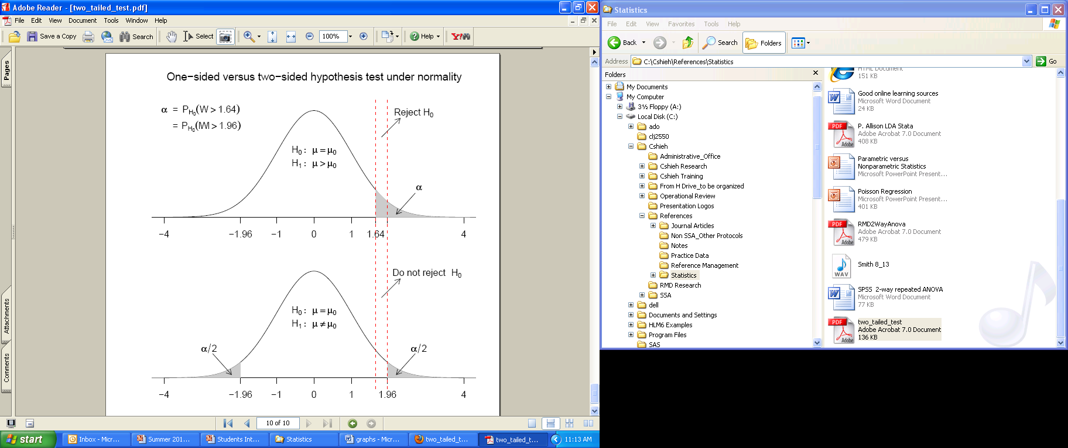
Source: http://www-personal.umich.edu/~titiunik

Slide 17
Parametric and Nonparametric Statistics

Slide 18
Assumptions for statistical distribution
Normal curve and large sample size are essential to statistical estimates.
However, in the clinical setting, we often deal with very unique research samples:
Relatively small sample size.
Not normally distributed.
How do we know data are not normally distributed?

Slide 19
Checking data distribution: Skewness and Kurtosis
Skewness: Examines the degree of asymmetry. A variable with perfectly normal distribution has a skewness of 0. In our example, INCOME has a positive value, indicating that there is a longer tail on the upper end.
Kurtosis: Measures the degree to which a distribution deviates from the “peak” of an ideal normal distribution. A normal distribution has a excess kurtosis=0. Here, excess kurtosis for Self-rated Weakness is negative, meaning that compared to a normal distribution, its central peak is lower and broader, and the tails are shorter.
 | N | Minimum | Maximum | Mean | Std. Deviation | Skewness | Kurtosis
Income (divided by 10,000) | 40 | 0 | 25 | 7.08 | 5.039 | 1.612 | 4.329
Logged Income (divided by 10,000) | 40 | -1.07 | 3.22 | 1.6342 | .96632 | -1.276 | 1.395
SF 36 Mental Composite Score | 40 | 19.03 | 64.23 | 49.0185 | 11.01156 | -1.069 | .820
Self-rated weakness | 40 | 0 | 10 | 4.82 | 3.768 | .098 | -1.682

Slide 20
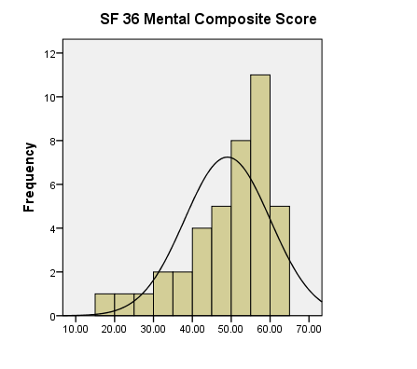
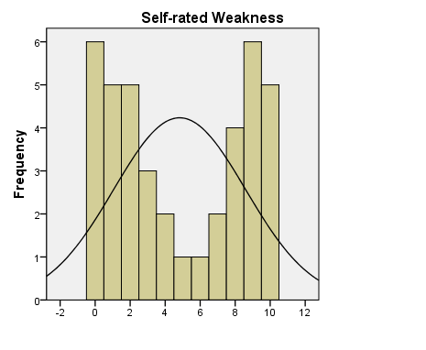
Examine data distribution with graphics
What can we do when data are not normally distributed?
J-Shaped Distribution
U-Shaped Distribution

Slide 21
Parametric statistics
Based on probability models, estimate the population parameters.
Key assumptions:
Data with a normal distribution.
If the analyses involve comparisons of group means, the variances of dependent variable scores are assumed to be equal across the populations that correspond to the groups in the study.
Additional assumptions may apply (for example: linearity), depending on the statistical methods.

Slide 22
Nonparametric statistics
Sampling distribution does not depend on any unknown parameters.
Advantage and disadvantage of the nonparametric estimation:
Advantage:
Does not rely on the parametric assumption, less stringent demands of the data.
Suitable for studies with small sample sizes.
Some methods are developed to handle ordinal data.
Relatively easy to calculate (you can calculate by hand).
Disadvantage:
Lack of statistical power, no parameters to describe.
May throw out useful information, ranking discards actual values.

Slide 23
Decision between parametric and nonparametric statistics
If your data generally fits the parametric assumptions, you probably want to use the parametric statistics (give you more statistical power).
Even for nonparametric statistics, an extremely small sample size is not desired.
Parametric and nonparametric statistics each has its own strengths and limitations.
Ask yourself: what are the advantages and disadvantages of each approach to your research project?

Slide 24
Comparison of parametric and nonparametric statistics
Parametric Statistics | Nonparametric Statistics | Purpose of Test
Independent sample t-test | Mann-Whitney U test | Compare difference between two groups
Paired t-test | Wilcoxon signed ranks test | Compare difference for two correlated samples (repeated measures, pre-post test, matched samples, etc.)
One-way ANOVA (with post-hoc test) | Kruskal-Wallis test | Compare differences across three or more groups
Repeated measurement ANOVA | Friedman test | Compare difference for three or more correlated samples (repeated measurement of multiple test points)
Pearson correlation coefficient | Spearman rank correlation coefficient; Kendall’s tau correlation coefficient | Assess the association between variables

Slide 25
Frequently used statistical techniques in clinical study

Slide 26
Chi-Square

Slide 27
Basics for Chi-square
Purpose: Examine whether there is a significant difference between the observed (from the actual data) and the expected cell frequencies (from the formula) in a contingency table.
Nonparametric statistics. Requires no assumption about the shape of the population or sampling distribution.
Variable requirements:
Nominal and ordinal level measurements can be used in this test.
Interval-ratio measurements have too many attributes, not suitable for the test. However, you can recode the variables into fewer categories before performing the Chi-square analysis.
Use column and row percentages in the contingency table to examine the “pattern”.

Slide 28





Computation of Chi-square
Question: Is there a relationship between gender and pain complain?
 |  | Gender |  | Total
 |  | Female | Male
Pain | Yes | 12 (C1R1) | 6 (C2R1) | 18
 | No | 9 (C1R2) | 13 (C2R2) | 22
Total |  | 21 | 19 | 40
First, we calculate expected frequencies with each marginal:
Then, we plug in the expected frequencies into the Chi-square formula:

Slide 29
Degrees of freedom
The number of independent pieces of information must be specified before all the rest can be determined.
Chi-square df= (r-1)(c-1). In our Gender vs. Pain example, the df= (2-1) (2-1)=1. Both variables have only 2 categories.
This is like playing “Sudoku”. In a 2X2 table, if we know the number of cases in one cell, the other three cells can be determined.
Why this is important? Because the shape of Chi-square distribution varies by its degrees of freedom.
 |  | Gender |  | Total
 |  | Female | Male
Pain | Yes | 12 | ? | 18
 | No | ? | ?
Total |  |  | 19 | 40

Slide 30
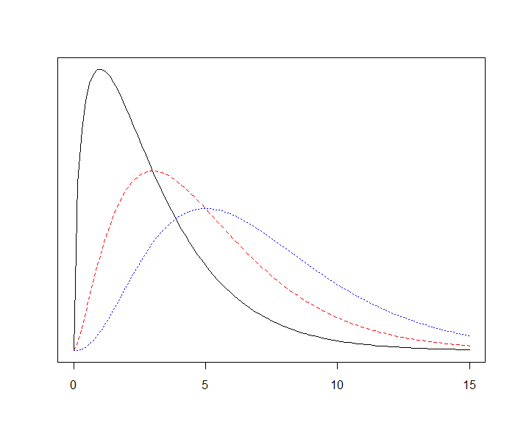
Chi-square distribution: Varies by degrees of freedom
Non-symmetric shape. However, when the degrees of freedom increase, the distribution will closer to normal.
The area under the curve=1.
Always positive value.
df=3
df=5
df=7

Slide 31
Limitations of Chi-square
Chi-Square is sensitive to sample size. With large samples, obtained Chi-square increases—even trivial and meaningless relationship may be statistically significant. Be cautious when you draw your conclusions.
If you have a small sample size and the cells have expected counts less than 5, the analysis is not valid. You should not use that result.
Solution: With reasonable assumptions, combine the cells/categories before you perform calculations.
Notes:
https://www.khanacademy.org/math/statistics-probability/inference-categorical-data-chi-square-tests

Slide 32
Independent sample t-test (Parametric)
and
Mann-Whitney U test (Non-parametric)

Slide 33
Basics
Purpose: Comparison of mean scores between two groups. In other words, the null hypothesis is:
Parametric statistics: Independent sample t-test.
Non-parametric statistics: Mann-Whitney U test.
Independent variable: Variable with two categories.
H0: μ1= μ2, or μ1- μ2=0

Slide 34
Example of independent sample t-test
Is there a gender difference in pain (score 0-10) among the patients?

Slide 35
Example of Mann-Whitney U test
Ranks
 | Gender | N | Mean Rank | Sum of Ranks
Pain_S | Female | 21 | 17.52 | 368.00
 | Male | 19 | 23.79 | 452.00
 | Total | 40
Test Statistics^{b}
 | Pain_S
Mann-Whitney U | 137.000
Z | -1.703
Asymp. Sig. (2-tailed) | .089
Exact Sig. [2*(1-tailed Sig.)] | .093ª
a. Not corrected for ties. b. Grouping Variable: Gender

Slide 36
Paired t-test (Parametric)
and
Wilcoxon Signed Ranks test (Non-parametric)

Slide 37
Basics
Compare mean difference in following senarios:
Between Pre vs. Post test (or repeated measure);
When two comparisons highly correlated with each other.
Parametric statistics: Paired t-test.
Non-parametric statistics: Wilcoxon Signed-Ranks test.
No grouping involved.
Here, we are testing whether the mean (or score) difference between the two tests equals 0.
H0: μtest1= μtest2

Slide 38
Example of paired t-test
Is there a significant difference between pre-test and post-test fatigue scores?

Slide 39
Example of Wilcoxon Signed-Ranks test
Ranks
 |  | N | Mean Rank | Sum of Ranks
Fatigue_Post - Fatigue_Pre | Negative Ranks | 30ª | 19.78 | 593.50
 | Positive Ranks | 7^{b} | 15.64 | 109.50
 | Ties | 3^{c}
 | Total | 40
a. Fatigue_Post < Fatigue_Pre b. Fatigue_Post > Fatigue_Pre c. Fatigue_Post = Fatigue_Pre
Test Statistics^{b}
 | Fatigue_Post - Fatigue_Pre
Z | -3.670ª
Asymp. Sig. (2-tailed) | .000
a. Based on positive ranks. b. Wilcoxon Signed Ranks Test

Slide 40
Pearson Correlation (parametric)
and
Spearman Correlation (Non-parametric)

Slide 41
Basics
Measures of association.
Correlation is not the same as causation.
There are various type of methods to examine association. Levels of measurement of the variables is the key concern for you to choose the proper method.
In a correlation matrix, you can examine whether there is a statistically significant relationship between each pair of variables.
Values along the diagonal is always 1.
The values across the diagonal is symmetrical. Sometimes researcher only present half of the matrix.

Slide 42
Pearson’s correlation
Purpose: It is a measure of association.
Ranges from 0 to ±1. The positive/negative sign indicates direction of the relationship.
Parametric statistics.
Key assumptions:
Each score should be independent of other scores.
Scores are normally distributed.
Scores on Y should be linearly related to scores on X.
Variable requirement: Interval-ratio variables.

Slide 43
Spearman correlation
Purpose: It is a measure of association.
Ranges from 0 to ±1. The positive/negative sign indicates direction of the relationship.
Nonparametric statistics.
Variable requirement: Ordinal variables.
If you have interval/ratio variables but the distribution of the data is not normalized, the Spearman correlation may be an option for you to consider.

Slide 44
Example of Pearson and Spearman correlations
Does patient’s age, pain, and frequency of crying correlate with each other?
Compare the results side-by-side.

Slide 45
Example of Pearson and Spearman correlations (Cont.)
Notes:
https://www.khanacademy.org/math/statistics-probability/describing-relationships-quantitative-data

Slide 46
Questions?
Feel free to email Ching-yi at ShiehChingyi@cc.nih.gov, THANK YOU!

